Slide 1

Subtype Polymorphism, Comparators, Comparable
Lecture 10 (Inheritance 3)
CS61B, Spring 2024 @ UC Berkeley
Slides credit: Josh Hug

Slide 2
Bonus Content: DMS and Type Checking Puzzle
Online Video Only
Lecture 10, CS61B, Spring 2024

Slide 3
A Typing Puzzle
Suppose we have two classes:
Dog: Implements bark() method.
ShowDog: Extends Dog, overrides bark method.
Summarizing is-a relationships, we have:
Every ShowDog is-a Dog
Every Dog is-an Object.
All types in Java are a subtype of Object.
Object
bark()
Dog
bark()
ShowDog

Slide 4
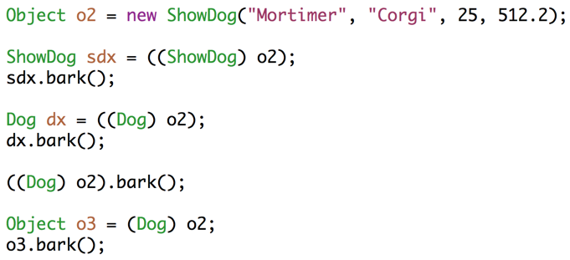
A Typing Puzzle
For each assignment, decide if it causes a compile error.
For each call to bark, decide whether: 1. Dog.bark() is called, 2. ShowDog.bark() is called, or 3. A syntax error results.
The rules:
Compiler allows memory box to hold any subtype.
Compiler allows calls based on static type.
Overridden non-static methods are selected at run time based on dynamic type.
Everything else is based on static type, including overloaded methods. Note: No overloaded methods for problem at left.

Slide 5


Static Type vs. Dynamic Type
Every variable in Java has a “compile-time type”, a.k.a. “static type”.
This is the type specified at declaration. Never changes!
Variables also have a “run-time type”, a.k.a. “dynamic type”.
This is the type specified at instantiation (e.g. when using new).
Equal to the type of the object being pointed at.
Static Type
Dynamic Type
LivingThing
lt1
LivingThing
Squid
a1
Animal
Animal
Fox
Fox
h1
Fox
Fox
Notes:
http://piq.codeus.net/static/media/userpics/piq_257076_400x400.png

Slide 6
Static Methods, Variables, and Inheritance
You may find questions on old 61B exams, worksheets, etc. that consider:
What if a subclass has variables with the same name as a superclass?
What if subclass has a static method with the same signature as a superclass method?
For static methods, we do not use the term overriding for this.
What if a subclass has methods that overload superclass methods?
These practices are generally not a good idea.
It is bad style.
There is almost no good reason to ever do this.
The rules for resolving the conflict are a bit confusing to learn.
I’ve pushed 61B away from learning these rules.
But if you want to learn them, see https://docs.oracle.com/javase/tutorial/java/IandI/override.html

Slide 7
Subtype Polymorphism vs. Explicit Higher Order Functions
Subtype Polymorphism vs. Explicit Higher Order Functions
Building a General Max Function
The Naive Approach
OurComparable
Compilation Error Puzzle
Comparable
Comparators
Lecture 10, CS61B, Spring 2024

Slide 8
Subtype Polymorphism
The biggest idea of the last couple of lectures: Subtype Polymorphism
Polymorphism: “providing a single interface to entities of different types”
Consider a variable deque of static type Deque:
When you call deque.addFirst(), the actual behavior is based on the dynamic type.
Java automatically selects the right behavior using what is sometimes called “dynamic method selection”.
Curious about alternatives to subtype polymorphism? See wiki or CS164.
a.k.a. compile-time type
a.k.a. run-time type
http://www.stroustrup.com/glossary.html#Gpolymorphism

Slide 9
Subtype Polymorphism vs. Explicit Higher Order Functions
Suppose we want to write a program that prints a string representation of the larger of two objects.
Sometimes called a “callback”.
def print_larger(x, y, compare, stringify):
if compare(x, y):
return stringify(x)
return stringify(y)
Explicit
HoF Approach
def print_larger(x, y):
if x.largerThan(y):
return x.str()
return y.str()
Not to be confused with the fascinating Dr. Ernest Kaulbach, who taught my Old English class.
Subtype Polymorphism Approach

Slide 10
The Naive Approach
Subtype Polymorphism vs. Explicit Higher Order Functions
Building a General Max Function
The Naive Approach
OurComparable
Compilation Error Puzzle
Comparable
Comparators
Lecture 10, CS61B, Spring 2024

Slide 11
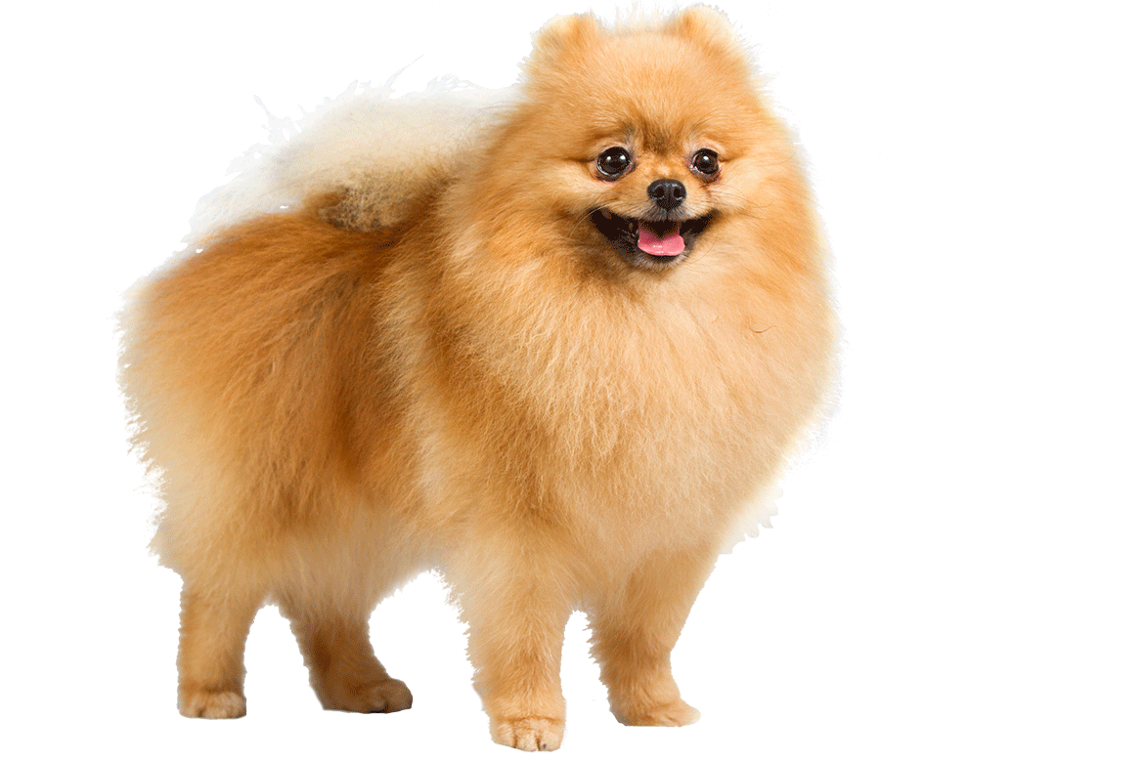


Goal: The One True Max Function
Suppose we want to write a function max() that returns the max of any array, regardless of type.
5
3
1
7
max
7
0 1 2 3
max
0 1 2
Sture
9 lbs
Elyse
3 lbs
Benjamin
15 lbs
Notes:
http://s5.postimg.org/z3o1av1lj/C_4.png
http://favoritedogbreed.com/wp-content/uploads/2015/07/Pomeranian_cutout.png
http://www.humanecharities.org.au/images/beagle.png

Slide 12
Compilation Error Challenge: yellkey.com/dog
Suppose we want to write a function max() that returns the max of any array, regardless of type. How many compilation errors are there in the code shown?
0
1
2
3
Maximizer.java
public static Object max(Object[] items) {
int maxDex = 0;
for (int i = 0; i < items.length; i += 1) {
if (items[i] > items[maxDex]) {
maxDex = i; }}
return items[maxDex];
}
DogLauncher.java
public static void main(String[] args) {
Dog[] dogs = {new Dog("Elyse", 3), new Dog("Sture", 9),
new Dog("Benjamin", 15)};
Dog maxDog = (Dog) Maximizer.max(dogs);
maxDog.bark();
}
Notes:
https://docs.google.com/forms/d/e/1FAIpQLSf3N5VgjI7RirMG89reAgYGAKhJxmq0Ddp8mTBpysi9g8Hq2w/viewform

Slide 13
Writing a General Max Function
Objects cannot be compared to other objects with >
One (bad) way to fix this: Write a max method in the Dog class.
Maximizer.java
public static Object max(Object[] items) {
int maxDex = 0;
for (int i = 0; i < items.length; i += 1) {
if (items[i] > items[maxDex]) {
maxDex = i; }}
return items[maxDex];
}
DogLauncher.java
public static void main(String[] args) {
Dog[] dogs = {new Dog("Elyse", 3), new Dog("Sture", 9),
new Dog("Benjamin", 15)};
Dog maxDog = (Dog) Maximizer.max(dogs);
maxDog.bark();
}

Slide 14
Dog.maxDog
One approach to maximizing a Dog array: Leave it to the Dog class.
What is the disadvantage of this?
/** Returns maximum of dogs. */
public static Dog maxDog(Dog[] dogs) {
if (dogs == null || dogs.length == 0) {
return null; }
Dog maxDog = dogs[0];
for (Dog d : dogs) {
if (d.size > maxDog.size) {
maxDog = d; }}
return maxDog;
}
Dog[] dogs = new Dog[]{d1, d2, d3};
Dog largest = Dog.maxDog(dogs);

Slide 15
The Fundamental Problem
Objects cannot be compared to other objects with >
How could we fix our Maximizer class using inheritance / HoFs?
Maximizer.java
public static Object max(Object[] items) {
int maxDex = 0;
for (int i = 0; i < items.length; i += 1) {
if (items[i] > items[maxDex]) {
maxDex = i; }}
return items[maxDex];
}
DogLauncher.java
public static void main(String[] args) {
Dog[] dogs = {new Dog("Elyse", 3), new Dog("Sture", 9),
new Dog("Benjamin", 15)};
Dog maxDog = (Dog) Maximizer.max(dogs);
maxDog.bark();
}

Slide 16
OurComparable
Subtype Polymorphism vs. Explicit Higher Order Functions
Building a General Max Function
The Naive Approach
OurComparable
Compilation Error Puzzle
Comparable
Comparators
Lecture 10, CS61B, Spring 2024

Slide 17
Solution
Create an interface that guarantees a comparison method.
Have Dog implement this interface.
Write Maximizer class in terms of this interface.
Interface inheritance says what a class can do, in this case compare.
public static OurComparable max(OurComparable[] items) { ...
OurComparable
compareTo(Object)
Dog
compareTo(Object)

Slide 18
Coding Demo: OurComparable
Maximizer.java
public class Maximizer {
public static Object max(Object[] items) {
int maxDex = 0;
for (int i = 0; i < items.length; i += 1) {
if (items[i] > items[maxDex]) {
maxDex = i;
}
}
return items[maxDex];
}
public static void main(String[] args) {
Dog[] dogs = {new Dog("Elyse", 3), new Dog("Sture", 9),
new Dog("Benjamin", 15)};
Dog maxDog = (Dog) Maximizer.max(dogs);
maxDog.bark();
}
}
This doesn't compile because you can't compare objects with the > operator.

Slide 19
Coding Demo: OurComparable
OurComparable.java
public interface OurComparable {
}

Slide 20
Coding Demo: OurComparable
OurComparable.java
public interface OurComparable {
public int compareTo(Object o);
}

Slide 21
Coding Demo: OurComparable
OurComparable.java
public interface OurComparable {
/** Return -1 if this < o.
* Return 0 if this equals o.
* Return 1 if this > o.
*/
public int compareTo(Object o);
}

Slide 22
Coding Demo: OurComparable
Dog.java
public class Dog {
private String name;
private int size;
}

Slide 23
Coding Demo: OurComparable
Dog.java
public class Dog implements OurComparable {
private String name;
private int size;
}

Slide 24
Coding Demo: OurComparable
Dog.java
public class Dog implements OurComparable {
private String name;
private int size;
public int compareTo(Object o) {
}
}

Slide 25
Coding Demo: OurComparable
Dog.java
public class Dog implements OurComparable {
private String name;
private int size;
/** Returns -1 if this dog is less than the dog pointed at by o, and so forth. */
public int compareTo(Object o) {
}
}

Slide 26
Coding Demo: OurComparable
Dog.java
public class Dog implements OurComparable {
private String name;
private int size;
/** Returns -1 if this dog is less than the dog pointed at by o, and so forth. */
public int compareTo(Object o) {
if (this.size < o.size) {
return -1;
}
}
}

Slide 27
Coding Demo: OurComparable
Dog.java
public class Dog implements OurComparable {
private String name;
private int size;
/** Returns -1 if this dog is less than the dog pointed at by o, and so forth. */
public int compareTo(Object o) {
if (this.size < o.size) {
return -1;
} else if (this.size == o.size) {
return 0;
}
}
}

Slide 28
Coding Demo: OurComparable
Dog.java
public class Dog implements OurComparable {
private String name;
private int size;
/** Returns -1 if this dog is less than the dog pointed at by o, and so forth. */
public int compareTo(Object o) {
if (this.size < o.size) {
return -1;
} else if (this.size == o.size) {
return 0;
}
return 1;
}
}

Slide 29
Coding Demo: OurComparable
Dog.java
public class Dog implements OurComparable {
private String name;
private int size;
/** Returns -1 if this dog is less than the dog pointed at by o, and so forth. */
public int compareTo(Object o) {
Dog uddaDog = (Dog) o;
if (this.size < uddaDog.size) {
return -1;
} else if (this.size == uddaDog.size) {
return 0;
}
return 1;
}
}

Slide 30
Coding Demo: OurComparable
Maximizer.java
public class Maximizer {
public static Object max(Object[] items) {
int maxDex = 0;
for (int i = 0; i < items.length; i += 1) {
if (items[i] > items[maxDex]) {
maxDex = i;
}
}
return items[maxDex];
}
public static void main(String[] args) {
Dog[] dogs = {new Dog("Elyse", 3), new Dog("Sture", 9),
new Dog("Benjamin", 15)};
Dog maxDog = (Dog) Maximizer.max(dogs);
maxDog.bark();
}
}

Slide 31
Coding Demo: OurComparable
Maximizer.java
public class Maximizer {
public static OurComparable max(OurComparable[] items) {
int maxDex = 0;
for (int i = 0; i < items.length; i += 1) {
if (items[i] > items[maxDex]) {
maxDex = i;
}
}
return items[maxDex];
}
public static void main(String[] args) {
Dog[] dogs = {new Dog("Elyse", 3), new Dog("Sture", 9),
new Dog("Benjamin", 15)};
Dog maxDog = (Dog) Maximizer.max(dogs);
maxDog.bark();
}
}

Slide 32
Coding Demo: OurComparable
Maximizer.java
public class Maximizer {
public static OurComparable max(OurComparable[] items) {
int maxDex = 0;
for (int i = 0; i < items.length; i += 1) {
int cmp = items[i].compareTo(items[maxDex]);
if (items[i] > items[maxDex]) {
maxDex = i;
}
}
return items[maxDex];
}
public static void main(String[] args) {
Dog[] dogs = {new Dog("Elyse", 3), new Dog("Sture", 9),
new Dog("Benjamin", 15)};
Dog maxDog = (Dog) Maximizer.max(dogs);
maxDog.bark();
}
}

Slide 33
Coding Demo: OurComparable
Maximizer.java
public class Maximizer {
public static OurComparable max(OurComparable[] items) {
int maxDex = 0;
for (int i = 0; i < items.length; i += 1) {
int cmp = items[i].compareTo(items[maxDex]);
if (cmp > 0) {
maxDex = i;
}
}
return items[maxDex];
}
public static void main(String[] args) {
Dog[] dogs = {new Dog("Elyse", 3), new Dog("Sture", 9),
new Dog("Benjamin", 15)};
Dog maxDog = (Dog) Maximizer.max(dogs);
maxDog.bark();
}
}

Slide 34
Coding Demo: OurComparable
Dog.java
public class Dog implements OurComparable {
private String name;
private int size;
/** Returns -1 if this dog is less than the dog pointed at by o, and so forth. */
public int compareTo(Object o) {
Dog uddaDog = (Dog) o;
if (this.size < uddaDog.size) {
return -1;
} else if (this.size == uddaDog.size) {
return 0;
}
return 1;
}
}
This code is kind of long. We can simplify it with the following trick.

Slide 35
Coding Demo: OurComparable
Dog.java
public class Dog implements OurComparable {
private String name;
private int size;
/** Returns <0 if this dog is less than the dog pointed at by o, and so forth. */
public int compareTo(Object o) {
Dog uddaDog = (Dog) o;
return this.size - uddaDog.size;
}
}
This code is kind of long. We can simplify it with the following trick.

Slide 36
Coding Demo: OurComparable
OurComparable.java
public interface OurComparable {
/** Return -1 if this < o.
* Return 0 if this equals o.
* Return 1 if this > o.
*/
public int compareTo(Object o);
}
We need to modify our interface specification accordingly.

Slide 37
Coding Demo: OurComparable
OurComparable.java
public interface OurComparable {
/** Return negative number if this < o.
* Return 0 if this equals o.
* Return positive number if this > o.
*/
public int compareTo(Object o);
}
We need to modify our interface specification accordingly.

Slide 38
The OurComparable Interface
Specification, returns:
Negative number if this is less than obj.
0 if this is equal to object.
Positive number if this is greater than obj.
public interface OurComparable {
int compareTo(Object o);
}
Could have also been OurComparable. No meaningful difference.

Slide 39
General Maximization Function Through Inheritance
the origin of uddaDog
public interface OurComparable {
int compareTo(Object o);
}
public class Dog implements OurComparable {
public int compareTo(Object obj) {
/** Warning, cast can cause runtime error! */
Dog uddaDog = (Dog) obj;
return this.size - uddaDog.size;
} ...
public class Maximizer {
public static OurComparable max(OurComparable[] a) {
...
}
Dog[] dogs = new Dog[]{d1, d2, d3};
Dog largest = (Dog) Maximizer.max(dogs);

Slide 40
General Maximization Function Through Inheritance
Benefits of this approach:
No need for array maximization code in every custom type (i.e. no Dog.maxDog(Dog[]) function required).
Code that operates on multiple types (mostly) gracefully, e.g.
OurComparable[] objs = getItems("somefile.txt");
return Maximizer.max(objs);

Slide 41
Compilation Error Puzzle
Subtype Polymorphism vs. Explicit Higher Order Functions
Building a General Max Function
The Naive Approach
OurComparable
Compilation Error Puzzle
Comparable
Comparators
Lecture 10, CS61B, Spring 2024

Slide 42
Interfaces Quiz #1: yellkey.com/TODO
public class DogLauncher {
public static void main(String[] args) {
...
Dog[] dogs = new Dog[]{d1, d2, d3};
System.out.println(Maximizer.max(dogs));
}
}
public class Dog
implements OurComparable {
...
public int compareTo(Object o) {
Dog uddaDog = (Dog) o;
return this.size
- uddaDog.size;
} ...
Q: If we omit compareTo(), which file will fail to compile?
DogLauncher.java
Dog.java
Maximizer.java
OurComparable.java
public class Maximizer {
public static OurComparable max(
OurComparable[] items) {
...
int cmp = items[i].
compareTo(items[maxDex]);
...
} ...
Notes:
https://docs.google.com/forms/d/e/1FAIpQLSc-f53zkUor7PBoEcbyzUnkE9mU_TOJ_0KORADbP1OUd5l9-Q/viewform
Dog will fail, because it fails to Override the required compareTo method.

Slide 43
Interfaces Quiz #2: yellkey.com/TODO
public class DogLauncher {
public static void main(String[] args) {
...
Dog[] dogs = new Dog[]{d1, d2, d3};
System.out.println(Maximizer.max(dogs));
}
}
public class Dog
implements OurComparable {
...
public int compareTo(Object o) {
Dog uddaDog = (Dog) o;
return this.size
- uddaDog.size;
} ...
Q: If we omit implements OurComparable, which file will fail to compile?
DogLauncher.java
Dog.java
Maximizer.java
OurComparable.java
public class Maximizer {
public static OurComparable max(
OurComparable[] items) {
...
int cmp = items[i].
compareTo(items[maxDex]);
...
} ...
Notes:
https://docs.google.com/forms/d/e/1FAIpQLSeiAWiPr9kvlHziy5mBkt8eDH0AwBrr2hHf48F0dANCwKwG4w/viewform
DogLauncher will fail, because Maximizer expects OurComparables.

Slide 44
Answers to Quiz
Problem 1: Dog will fail to compile because it does not implement all abstract methods required by OurComparable interface. (And I suppose DogLauncher will fail as well since Dog.class doesn’t exist)
Problem 2: DogLauncher will fail, because it tries to pass things that are not OurComparables, and Maximizer expects OurComparables.

Slide 45
Comparable
Subtype Polymorphism vs. Explicit Higher Order Functions
Building a General Max Function
The Naive Approach
OurComparable
Compilation Error Puzzle
Comparable
Comparators
Lecture 10, CS61B, Spring 2024

Slide 46
The Issues With OurComparable
Two issues:
Awkward casting to/from Objects.
We made it up.
No existing classes implement OurComparable (e.g. String, etc).
No existing classes use OurComparable (e.g. no built-in max function that uses OurComparable)
public class Dog implements OurComparable {
public int compareTo(Object obj) {
/** Warning, cast can cause runtime error! */
Dog uddaDog = (Dog) obj;
return this.size - uddaDog.size;
} ...
Dog[] dogs = new Dog[]{d1, d2, d3};
Dog largest = (Dog) Maximizer.max(dogs);

Slide 47
The Issues With OurComparable
Two issues:
Awkward casting to/from Objects.
We made it up.
No existing classes implement OurComparable (e.g. String, etc).
No existing classes use OurComparable (e.g. no built-in max function that uses OurComparable)
The industrial strength approach: Use the built-in Comparable interface.
Already defined and used by tons of libraries. Uses generics.
public interface Comparable<T> {
public int compareTo(T obj);
}
public interface OurComparable {
public int compareTo(Object obj);
}

Slide 48
Coding Demo: Comparable
Dog.java
public class Dog implements OurComparable {
private String name;
private int size;
/** Returns <0 if this dog is less than the dog pointed at by o, and so forth. */
public int compareTo(Object o) {
Dog uddaDog = (Dog) o;
return this.size - uddaDog.size;
}
}
public interface Comparable<T> {
public int compareTo(T obj);
}
Replacing OurComparable with the built-in Comparable interface.

Slide 49
Coding Demo: Comparable
Dog.java
public class Dog implements Comparable<Dog> {
private String name;
private int size;
/** Returns <0 if this dog is less than the dog pointed at by o, and so forth. */
public int compareTo(Object o) {
Dog uddaDog = (Dog) o;
return this.size - uddaDog.size;
}
}
public interface Comparable<T> {
public int compareTo(T obj);
}
Replacing OurComparable with the built-in Comparable interface.

Slide 50
Coding Demo: Comparable
Dog.java
public class Dog implements Comparable<Dog> {
private String name;
private int size;
/** Returns <0 if this dog is less than the dog pointed at by o, and so forth. */
public int compareTo(Dog uddaDog) {
return this.size - uddaDog.size;
}
}
public interface Comparable<T> {
public int compareTo(T obj);
}
Replacing OurComparable with the built-in Comparable interface.

Slide 51
Coding Demo: OurComparable
Maximizer.java
public class Maximizer {
public static OurComparable max(OurComparable[] items) {
int maxDex = 0;
for (int i = 0; i < items.length; i += 1) {
int cmp = items[i].compareTo(items[maxDex]);
if (cmp > 0) {
maxDex = i;
}
}
return items[maxDex];
}
}

Slide 52
Coding Demo: OurComparable
Maximizer.java
public class Maximizer {
public static Comparable max(Comparable[] items) {
int maxDex = 0;
for (int i = 0; i < items.length; i += 1) {
int cmp = items[i].compareTo(items[maxDex]);
if (cmp > 0) {
maxDex = i;
}
}
return items[maxDex];
}
}

Slide 53
Comparable vs. OurComparable
OurComparable
Comparable<Dog>
compareTo(Object)
compareTo(Dog)
Dog
Dog
compareTo(Object)
compareTo(Dog)

Slide 54
Comparable Advantages
Lots of built in classes implement Comparable (e.g. String).
Lots of libraries use the Comparable interface (e.g. Arrays.sort)
Avoids need for casts.
public class Dog implements Comparable<Dog> {
public int compareTo(Dog uddaDog) {
return this.size - uddaDog.size;
}
Much better!
public class Dog implements OurComparable {
public int compareTo(Object obj) {
Dog uddaDog = (Dog) obj;
return this.size - uddaDog.size;
} ...
Implementing Comparable allows library functions to compare custom types (e.g. finding max).
Dog[] dogs = new Dog[]{d1, d2, d3};
Dog largest = Collections.max(Arrays.asList(dogs));

Slide 55
Comparators
Subtype Polymorphism vs. Explicit Higher Order Functions
Building a General Max Function
The Naive Approach
OurComparable
Compilation Error Puzzle
Comparable
Comparators
Lecture 10, CS61B, Spring 2024

Slide 56

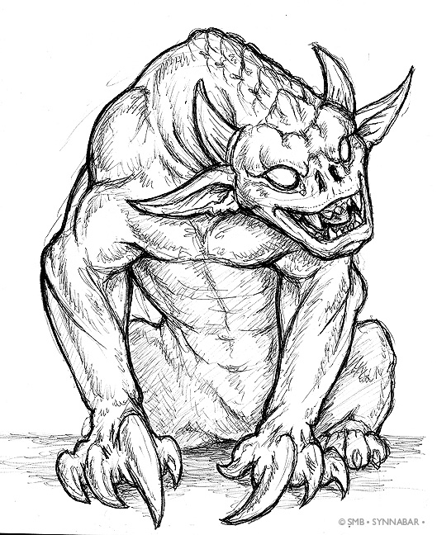
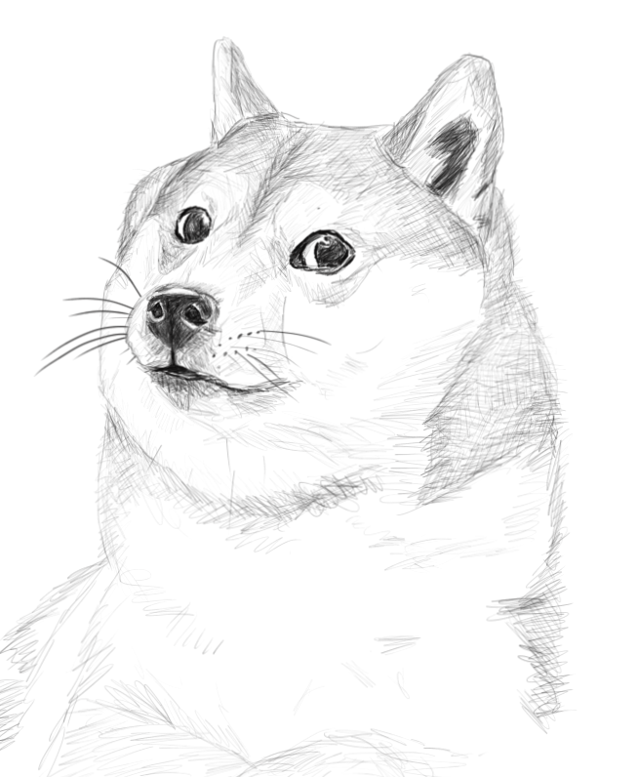
Natural Order
The term “Natural Order” is sometimes used to refer to the ordering implied by a Comparable’s compareTo method.
Example: Dog objects (as we’ve defined them) have a natural order given by their size.
“Doge”, size: 5
“Grigometh”, size: 200
“Clifford”, size: 9000

Slide 57
Natural Order
May wish to order objects in a different way.
Example: By Name.
“Doge”, size: 5
“Grigometh”, size: 200
“Clifford”, size: 9000

Slide 58
Subtype Polymorphism vs. Explicit Higher Order Functions
Suppose we want to write a program that prints a string representation of the larger of two objects according to some specific comparison function.
def print_larger(x, y, compare, stringify):
if compare(x, y):
return stringify(x)
return stringify(y)
Explicit
HoF Approach
def print_larger(T x, T y):
if x.largerThan(y):
return x.str()
return y.str()
Can simply pass a different compare function.
Subtype Polymorphism Approach??

Slide 59
Subtype Polymorphism vs. Explicit Higher Order Functions
Suppose we want to write a program that prints a string representation of the larger of two objects according to some specific comparison function.
Some possible designs (not the best):
Add more functions compareTo2, compareTo3, compareTo4, etc.
Add an extra argument to specify which comparison you want: public int compareTo(Dog uddaDog, String whichCompare)
def print_larger(x, y, compare, stringify):
if compare(x, y):
return stringify(x)
return stringify(y)
Explicit
HoF Approach
Can simply pass a different compare function.

Slide 60
Subtype Polymorphism vs. Explicit Higher Order Functions
Suppose we want to write a program that prints a string representation of the larger of two objects according to some specific comparison function.
def print_larger(x, y, compare, stringify):
if compare(x, y):
return stringify(x)
return stringify(y)
Explicit
HoF Approach
def print_larger(T x, T y, comparator<T> c):
if c.compare(x, y):
return x.str()
return y.str()
Can simply pass a different compare function.
Subtype Polymorphism Approach

Slide 61
Coding Demo: Comparator
Dog.java
public class Dog implements Comparable<Dog> {
private String name;
private int size;
/** Returns <0 if this dog is less than the dog pointed at by o, and so forth. */
public int compareTo(Dog uddaDog) {
return this.size - uddaDog.size;
}
}

Slide 62
Coding Demo: Comparator
Dog.java
public class Dog implements Comparable<Dog> {
private String name;
private int size;
/** Returns <0 if this dog is less than the dog pointed at by o, and so forth. */
public int compareTo(Dog uddaDog) {
return this.size - uddaDog.size;
}
public class NameComparator implements Comparator<Dog> {
}
}

Slide 63
Coding Demo: Comparator
Dog.java
import java.util.Comparator;
public class Dog implements Comparable<Dog> {
private String name;
private int size;
/** Returns <0 if this dog is less than the dog pointed at by o, and so forth. */
public int compareTo(Dog uddaDog) {
return this.size - uddaDog.size;
}
public class NameComparator implements Comparator<Dog> {
}
}

Slide 64
Coding Demo: Comparator
Dog.java
import java.util.Comparator;
public class Dog implements Comparable<Dog> {
private String name;
private int size;
/** Returns <0 if this dog is less than the dog pointed at by o, and so forth. */
public int compareTo(Dog uddaDog) {
return this.size - uddaDog.size;
}
public class NameComparator implements Comparator<Dog> {
public int compare(Dog a, Dog b) {
}
}
}

Slide 65
Coding Demo: Comparator
Dog.java
import java.util.Comparator;
public class Dog implements Comparable<Dog> {
private String name;
private int size;
/** Returns <0 if this dog is less than the dog pointed at by o, and so forth. */
public int compareTo(Dog uddaDog) {
return this.size - uddaDog.size;
}
public class NameComparator implements Comparator<Dog> {
public int compare(Dog a, Dog b) {
return a.name.compareTo(b.name);
}
}
}

Slide 66
Coding Demo: Comparator
Dog.java
import java.util.Comparator;
public class Dog implements Comparable<Dog> {
private String name;
private int size;
/** Returns <0 if this dog is less than the dog pointed at by o, and so forth. */
public int compareTo(Dog uddaDog) {
return this.size - uddaDog.size;
}
public static class NameComparator implements Comparator<Dog> {
public int compare(Dog a, Dog b) {
return a.name.compareTo(b.name);
}
}
}

Slide 67
Coding Demo: Comparator
DogLauncher.java
public class DogLauncher {
public static void main(String[] args) {
Dog d1 = new Dog("Elyse", 3);
Dog d2 = new Dog("Sture", 9);
Dog d3 = new Dog("Benjamin", 15);
Dog[] dogs = new Dog[]{d1, d2, d3};
}
}

Slide 68
Coding Demo: Comparator
DogLauncher.java
public class DogLauncher {
public static void main(String[] args) {
Dog d1 = new Dog("Elyse", 3);
Dog d2 = new Dog("Sture", 9);
Dog d3 = new Dog("Benjamin", 15);
Dog[] dogs = new Dog[]{d1, d2, d3};
Dog.NameComparator nc = new Dog.NameComparator();
}
}

Slide 69
Coding Demo: Comparator
DogLauncher.java
public class DogLauncher {
public static void main(String[] args) {
Dog d1 = new Dog("Elyse", 3);
Dog d2 = new Dog("Sture", 9);
Dog d3 = new Dog("Benjamin", 15);
Dog[] dogs = new Dog[]{d1, d2, d3};
Dog.NameComparator nc = new Dog.NameComparator();
if (nc.compare(d1, d3) > 0) { // if d1 comes later than d3 in the alphabet
}
}
}

Slide 70
Coding Demo: Comparator
DogLauncher.java
public class DogLauncher {
public static void main(String[] args) {
Dog d1 = new Dog("Elyse", 3);
Dog d2 = new Dog("Sture", 9);
Dog d3 = new Dog("Benjamin", 15);
Dog[] dogs = new Dog[]{d1, d2, d3};
Dog.NameComparator nc = new Dog.NameComparator();
if (nc.compare(d1, d3) > 0) { // if d1 comes later than d3 in the alphabet
d1.bark();
}
}
}

Slide 71
Coding Demo: Comparator
DogLauncher.java
public class DogLauncher {
public static void main(String[] args) {
Dog d1 = new Dog("Elyse", 3);
Dog d2 = new Dog("Sture", 9);
Dog d3 = new Dog("Benjamin", 15);
Dog[] dogs = new Dog[]{d1, d2, d3};
Dog.NameComparator nc = new Dog.NameComparator();
if (nc.compare(d1, d3) > 0) { // if d1 comes later than d3 in the alphabet
d1.bark();
} else {
d3.bark();
}
}
}

Slide 72
Coding Demo: Comparator
Slight change to reflect Java convention.
Dog.java
import java.util.Comparator;
public class Dog implements Comparable<Dog> {
private String name;
private int size;
/** Returns <0 if this dog is less than the dog pointed at by o, and so forth. */
public int compareTo(Dog uddaDog) {
return this.size - uddaDog.size;
}
public static class NameComparator implements Comparator<Dog> {
public int compare(Dog a, Dog b) {
return a.name.compareTo(b.name);
}
}
}

Slide 73
Coding Demo: Comparator
Slight change to reflect Java convention.
Dog.java
import java.util.Comparator;
public class Dog implements Comparable<Dog> {
private String name;
private int size;
/** Returns <0 if this dog is less than the dog pointed at by o, and so forth. */
public int compareTo(Dog uddaDog) {
return this.size - uddaDog.size;
}
private static class NameComparator implements Comparator<Dog> {
public int compare(Dog a, Dog b) {
return a.name.compareTo(b.name);
}
}
}

Slide 74
Coding Demo: Comparator
Slight change to reflect Java convention.
Dog.java
import java.util.Comparator;
public class Dog implements Comparable<Dog> {
private String name;
private int size;
/** Returns <0 if this dog is less than the dog pointed at by o, and so forth. */
public int compareTo(Dog uddaDog) {
return this.size - uddaDog.size;
}
private static class NameComparator implements Comparator<Dog> {
public int compare(Dog a, Dog b) {
return a.name.compareTo(b.name);
}
}
public static Comparator<Dog> getNameComparator() {
}
}

Slide 75
Coding Demo: Comparator
Slight change to reflect Java convention.
Dog.java
import java.util.Comparator;
public class Dog implements Comparable<Dog> {
private String name;
private int size;
/** Returns <0 if this dog is less than the dog pointed at by o, and so forth. */
public int compareTo(Dog uddaDog) {
return this.size - uddaDog.size;
}
private static class NameComparator implements Comparator<Dog> {
public int compare(Dog a, Dog b) {
return a.name.compareTo(b.name);
}
}
public static Comparator<Dog> getNameComparator() {
return new NameComparator();
}
}

Slide 76
Coding Demo: Comparator
Slight change to reflect Java convention.
DogLauncher.java
public class DogLauncher {
public static void main(String[] args) {
Dog d1 = new Dog("Elyse", 3);
Dog d2 = new Dog("Sture", 9);
Dog d3 = new Dog("Benjamin", 15);
Dog[] dogs = new Dog[]{d1, d2, d3};
Dog.NameComparator nc = new Dog.NameComparator();
if (nc.compare(d1, d3) > 0) { // if d1 comes later than d3 in the alphabet
d1.bark();
} else {
d3.bark();
}
}
}

Slide 77
Coding Demo: Comparator
Slight change to reflect Java convention.
DogLauncher.java
public class DogLauncher {
public static void main(String[] args) {
Dog d1 = new Dog("Elyse", 3);
Dog d2 = new Dog("Sture", 9);
Dog d3 = new Dog("Benjamin", 15);
Dog[] dogs = new Dog[]{d1, d2, d3};
Dog.NameComparator nc = Dog.getNameComparator();
if (nc.compare(d1, d3) > 0) { // if d1 comes later than d3 in the alphabet
d1.bark();
} else {
d3.bark();
}
}
}

Slide 78
Coding Demo: Comparator
Slight change to reflect Java convention.
DogLauncher.java
public class DogLauncher {
public static void main(String[] args) {
Dog d1 = new Dog("Elyse", 3);
Dog d2 = new Dog("Sture", 9);
Dog d3 = new Dog("Benjamin", 15);
Dog[] dogs = new Dog[]{d1, d2, d3};
Comparator<Dog> nc = Dog.getNameComparator();
if (nc.compare(d1, d3) > 0) { // if d1 comes later than d3 in the alphabet
d1.bark();
} else {
d3.bark();
}
}
}

Slide 79
Coding Demo: Comparator
Slight change to reflect Java convention.
DogLauncher.java
import java.util.Comparator;
public class DogLauncher {
public static void main(String[] args) {
Dog d1 = new Dog("Elyse", 3);
Dog d2 = new Dog("Sture", 9);
Dog d3 = new Dog("Benjamin", 15);
Dog[] dogs = new Dog[]{d1, d2, d3};
Comparator<Dog> nc = Dog.getNameComparator();
if (nc.compare(d1, d3) > 0) { // if d1 comes later than d3 in the alphabet
d1.bark();
} else {
d3.bark();
}
}
}

Slide 80
Additional Orders in Java
In some languages, we’d write two comparison functions and simply pass the one we want :
sizeCompare()
nameCompare()
The standard Java approach: Create SizeComparator and NameComparator classes that implement the Comparator interface.
Requires methods that also take Comparator arguments (see project 1C).
public interface Comparator<T> {
int compare(T o1, T o2);
}

Slide 81
Dogs and Comparators
Dog not related by inheritance to any of the classes below.
public interface Comparator<T> {
int compare(T o1, T o2);
}
Dog
compare(T, T)
Comparator<T>
compare(Dog, Dog)
NameComparator
compare(Dog, Dog)
SizeComparator

Slide 82
Example: NameComparator
public class Dog implements Comparable<Dog> {
private String name;
private int size;
public static class NameComparator implements Comparator<Dog> {
public int compare(Dog d1, Dog d2) {
return d1.name.compareTo(d2.name);
}
}
...
}
Comparator<Dog> cd = new Dog.NameComparator();
if (cd.compare(d1, d3) > 0) {
d1.bark();
} else {
d3.bark();
}
Result: If d1 has a name that comes later in the alphabet than d3, d1 barks.

